Slide 1
Vision-Based Autonomous Quadrotor Landing on a Moving Platform
Barbieri Lorenzo (2144036)
Carotenuto Alessandro (1847282)
Sandri Leonardo (2137374)

Slide 2
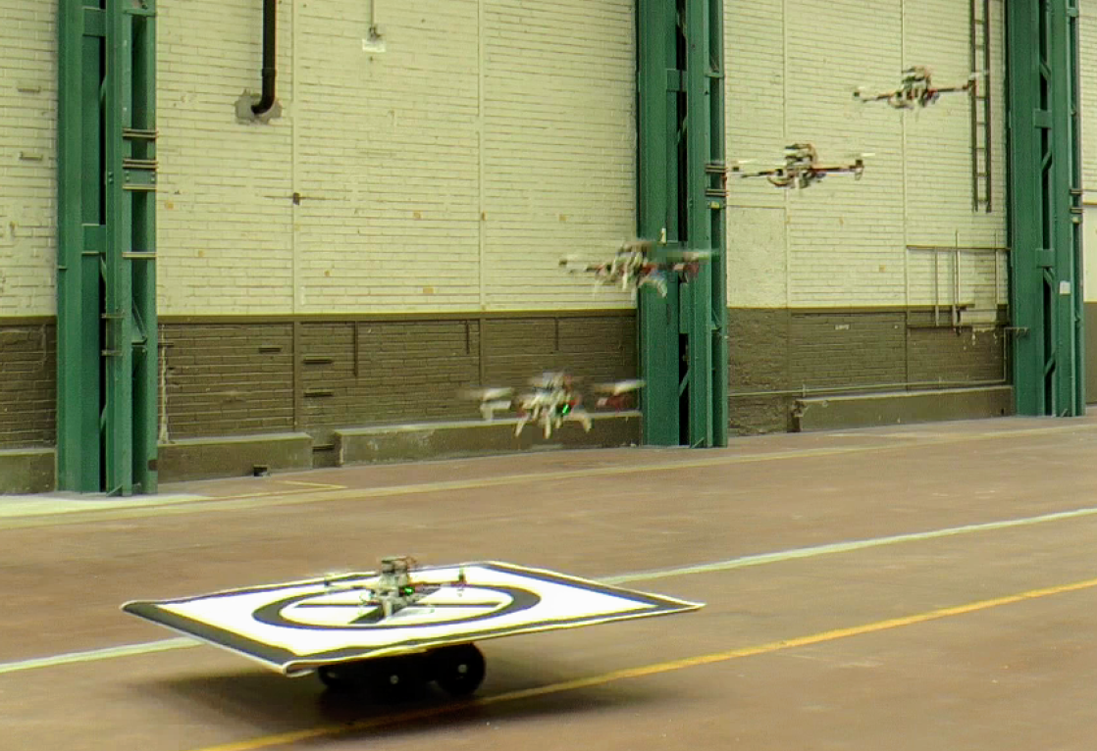
Introduction
Reference work:
(Falanga et al.) “Vision-based Autonomous Quadrotor Landing on a Moving Platform”
With the aim to extend mission duration for aerial vehicles, explored approach is to craft an efficient autonomous system to enable landing on a moving platform, based on vision detection.
This enables battery swapping on platforms that are considered charging stations.

Slide 3
Introduction
Workflow structure:
Two-phases approach:
Known platform trajectories
Unknown platform trajectories
First, we worked on a simplified version with known platform trajectories to test the core control and planning components; second, we implemented the complete system with unknown trajectories incorporating vision-based detection and Kalman filtering for platform state estimation.

Slide 4
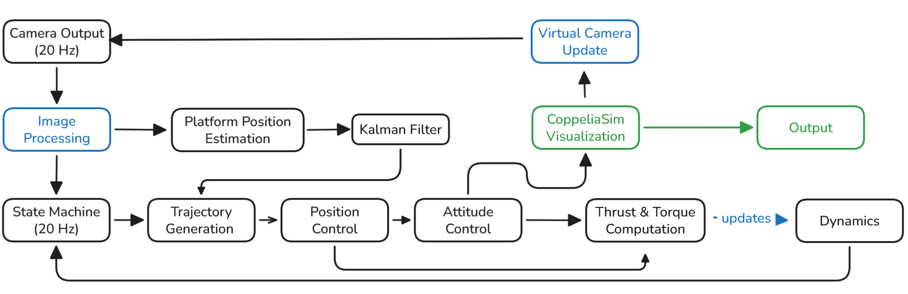
Our Implementation
General final (unknown trajectories) pipeline and data flow:
We organized our work focusing on building a modular architecture, through our two-phases implementation approach, optimizing the workflow with practical design insights that worked well in practice despite diverging from the paper.
Notes:
- We obtain the visual data from the camera
- We process that
- That goes both into our platform trajectory estimation modulues
- And into our state machine, which that would choose which trajectory to generate
- Then the control system will update the dynamics and the visualization

Slide 5
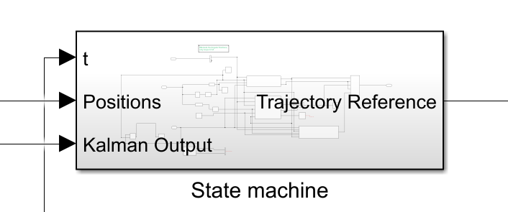
State Machine Logic
The State Machine is the coordinator of the whole simulation.
It outputs the reference trajectory for the quadrotor
controller based on the current flying phase.
Flight states:
TAKEOFF-HOVERING
Vertical Ascension with constant velocity and hovering until platform detection
SEARCH
If detection failed the quadrotor starts moving around to find it
TRACKING
Once the platform is detected the drone starts following it from above
LANDING
After tracking error converges the quadrotor gently lands on the platform
Notes:
In the following slides we’re going to show the core of the tracking model, so we’ll start by stating how we generate the trajectories. That’s done by a state machine that regulates the phases of the flight. Our state machine takes in account 4 possible states. The first consists in the takeoff and initial hovering so the state machine will output a gentle vertical trajectory until the drone reach a threshold and from that point on it just needs to stay at level.
Then we have 2 alternatives.
If the drone detects the platform while hovering it then enters the tracking state, otherwise If the drone hasnt detected the platform in the time it was hovering then we enter the search state where it starts flying around the workspace along a wide radius circle until it detect the platform. If the drone detects the platform while flying around it the state machine pass to the tracking phase.
In this phase the drone lower its altitude a bit and starts following the platform until the x-y error converges.
Then, when the tracking is stable we pass to the landing phase where we gently start decreasing altitude and at the end perform the actual landing.

Slide 6

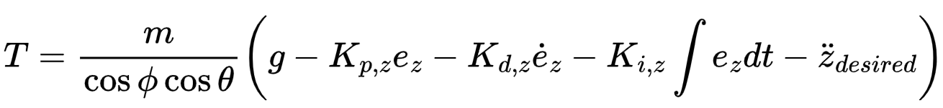

Control Scheme
Cascade hierarchical control system:
Outer Loop: Position control
Turns trajectory error into the necessary total thrust and use it to output the desired attitude angles.
Inner Loop: Attitude control
Thrust
Traj_error
Position controller
Dynamic model
State
Euler_des
Attitude controller
Notes:
The trajectory generated by the state machine is then passed as reference to the controller which is a cascade hierarchical controller where we find the position controller on the outer loop and the attitude controller on the inner loop.
Both controllers are PID controllers with feedforward terms.
The position controller computes the required thrust in order to recover from the errors along x y and z and determines the reference attitude for the attitude controller which then computes the required torques according to the formula shown in the slide.
Required thrust and torques are then combined and passed to the dynamic model
Instead of a fixed yaw, the controller calculates the target Yaw $\psi_d$ based on the velocity vector (atan2(y_d_dot, x_d_dot)). This forces the drone to face the direction it is flying

Slide 7
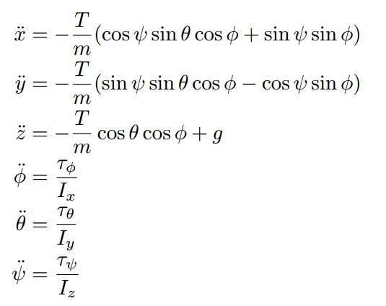
Dynamic Model
Simplified model seen during lectures.
Neglected:
Aerodynamics
Gyroscopic effects
Assumed:
Small roll and pitch angles
Symmetric shape
Negligible disturbances
Notes:
Then thrust and torques are converted according to the dynamic model into accelerations that will then be integrated to define the velocity and position of the drone.
As we can notice we used the simplified dynamic model seen during the lectures because it was suitable for a project like ours consisting in just simulations and not real life outdoor application. So no aerodynymics and gyroscopic effects were modeled. Small roll and pitch angles were ensured by limiting the possible reference angles given in output by the position controller.

Slide 8
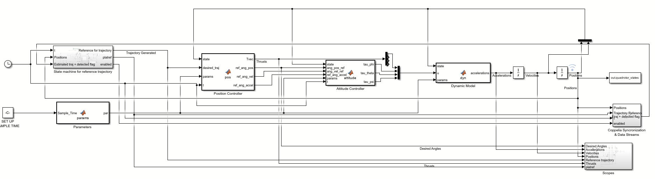
Simulation and Control environments
The simulation and control system implementations relies on Matlab/Simulink for all the computational tasks, it is integrated and synchronized with CoppeliaSim for both 3D visualization purposes and especially, camera simulation purposes.

Slide 9
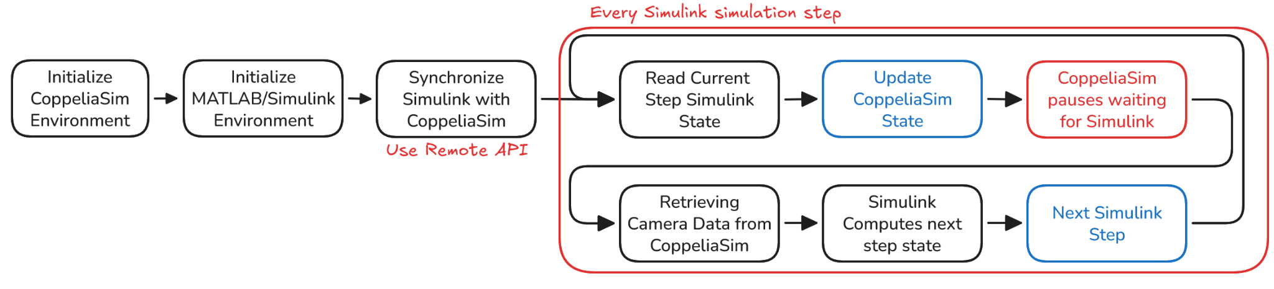
Software Integration Pipeline
Simplified pipeline of how the different software systems interact with each other:

Slide 10

Platform Detection
Platform detection relies on a visual tag of known dimension mounted on the moving platform, shown on the right.
Platform detection can be broken down into five phases:
Binary Image, converting the image into grayscale and thresholding it to obtain a binary image.
Connected Components: Find all white regions in the image
Largest Quadrangle: Select the largest white region
Pattern Matching: Inside the region, search for Circle, Cross or Quadrangle corners, in this order
Outlier Filtering: Apply RANSAC to the detected corners to reject spurious detections.

Slide 11
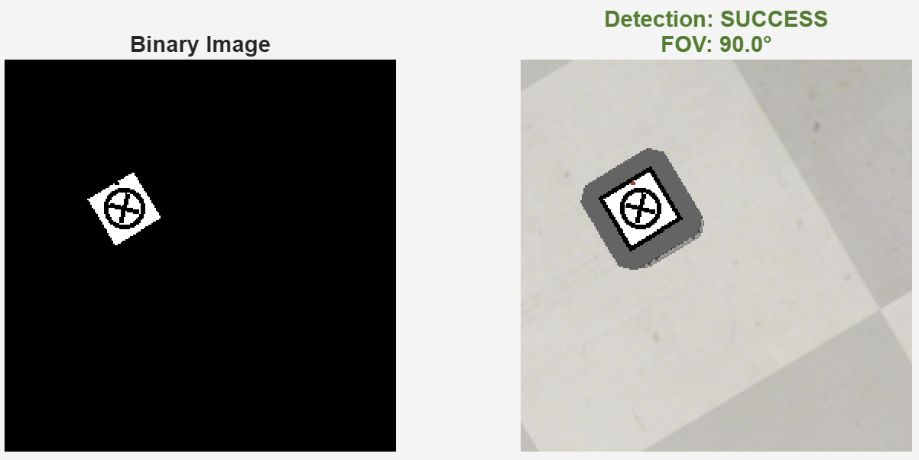
Detection Debug Examples

Slide 12
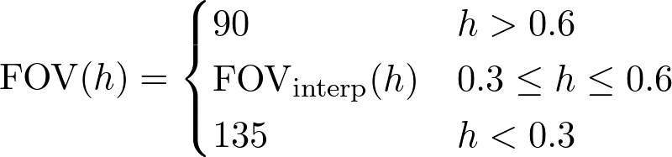
Adaptive Field-Of-View
To prevent detection interruption and/or to reduce estimation error during final portion of the landing phase, we included an Adaptive Field-Of-View which increases the FOV if the drone is too
close to the ground.
Where between an altitude of 0,3 m and 0,6 m we linearly interpolate between the two saturation
values.

Slide 13
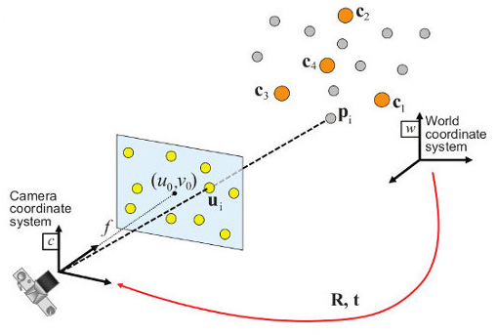
3D Position Recovery (1/2), PnP
Once four corners are detected, we solve the Perspective-n-Point (PnP) problem to recover the platform's 3D pose, knowing tag size.
PnP Pipeline:
Homography Computation: Compute homography H from tag corners to normalized image coordinates
Decomposition: Extract rotation R and translation t from H = λ[r₁ r₂ t]
SVD Orthogonalization: Enforce R as proper rotation matrix via SVD, fixing possible numerical errors
Validation: Verify positive depth (Z > 0), reasonable range and other red flags for debugging

Slide 14
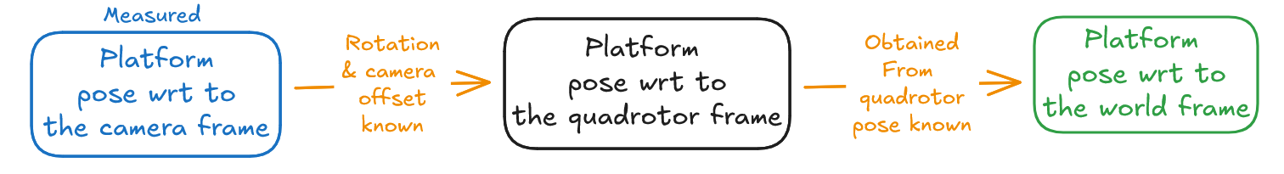
3D Position Recovery (2/2), Coordinate Transform
After having obtained the Platform position wrt to the camera we need to obtain the 3D position in the world reference frame, detection and calculations run at 20 Hz. In sequence:
Mathematically:

Slide 15


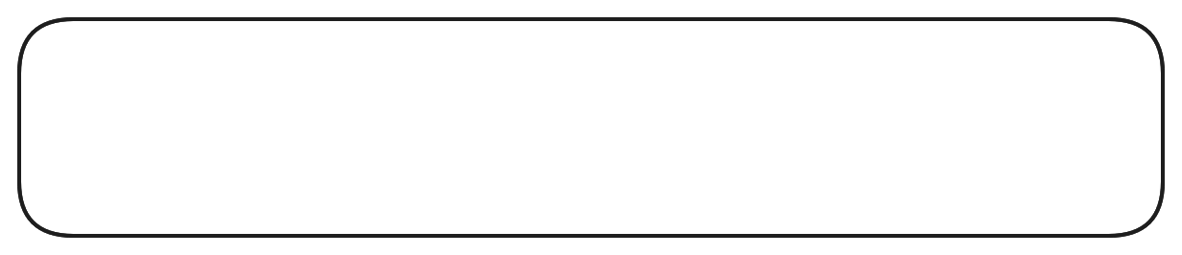
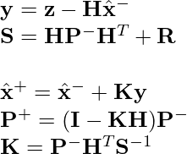

Kalman Filter for Platform prediction
We use a Kalman Filter to smooth noisy and flickery camera detections and to estimate platform velocity, it does not perform a measurement update in case of too large attitude updates (Attitude Gating) or in case of a failed detection frame.
Motion Model: Where the state-transition matrix is:
Measurement: Measurement Matrix:
Prediction Step: Measurement Update:

Slide 16
Experimental Validation
Our architecture has been tested on 3 different scenarios:
Platform moving linearly
Platform moving in a circle
Platform performing an Figure-8 trajectory
In each scenario the platform is moving at constant velocity.
Notes:
Our design has been validated by making the platform moving in 3 different ways So the first scenario consisted in the platform moving along a straight line, the second scenario consisted in the platform moving on a circular trajectory and lastly the platform performed an 8 figure trajectory.
In all scenarios the platform moved with constant velocity.

Slide 17
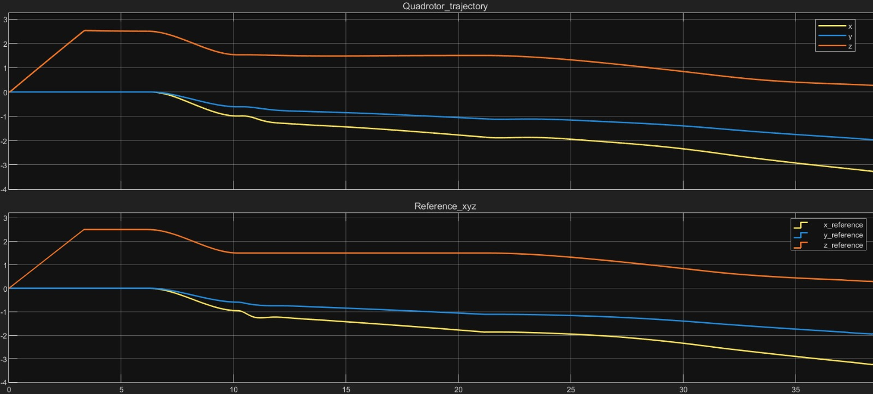
Linear Platform Trajectory: Position tracking
Takeoff
Hovering
Tracking
Landing
Smooth tracking
The error along z lies between 0 and 0.03
The errors along x and y remains bounded between 0 and 0.04
Notes:
In the next slides I’m going to show results we achieved in the presented scenarios from the complete architecture, including vision. So starting from the linear trajectory case we can see here at the bottom the reference trajectory produced by the state machine and at the top the actual trajectory followed by the quadrotor.
By looking at the orange line, representing the z axis, we can see the different states of the flight: we notice the gradual takeoff, the hovering, the following and the very gentle landing.
As we can see we put a lot on emphasys on the generation of smooth trajectories without vertical steps and the results are very good.

Slide 18
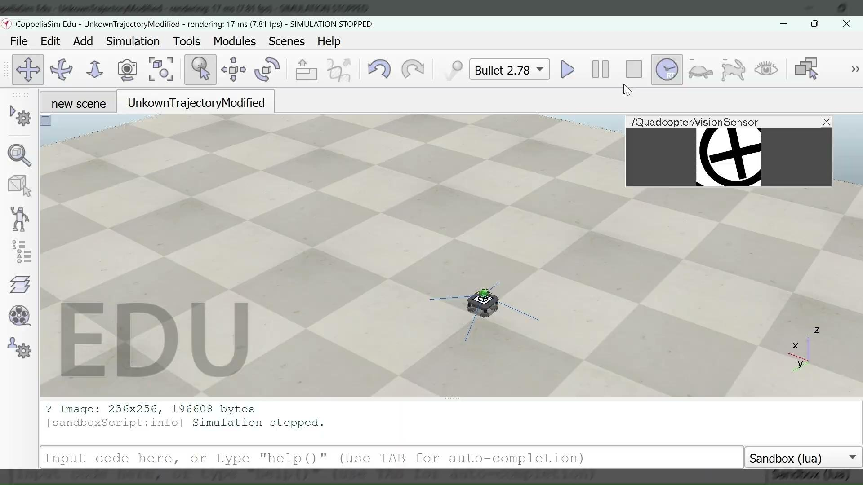
Linear Platform Trajectory: Video
Notes:
Here is the video for this case

Slide 19
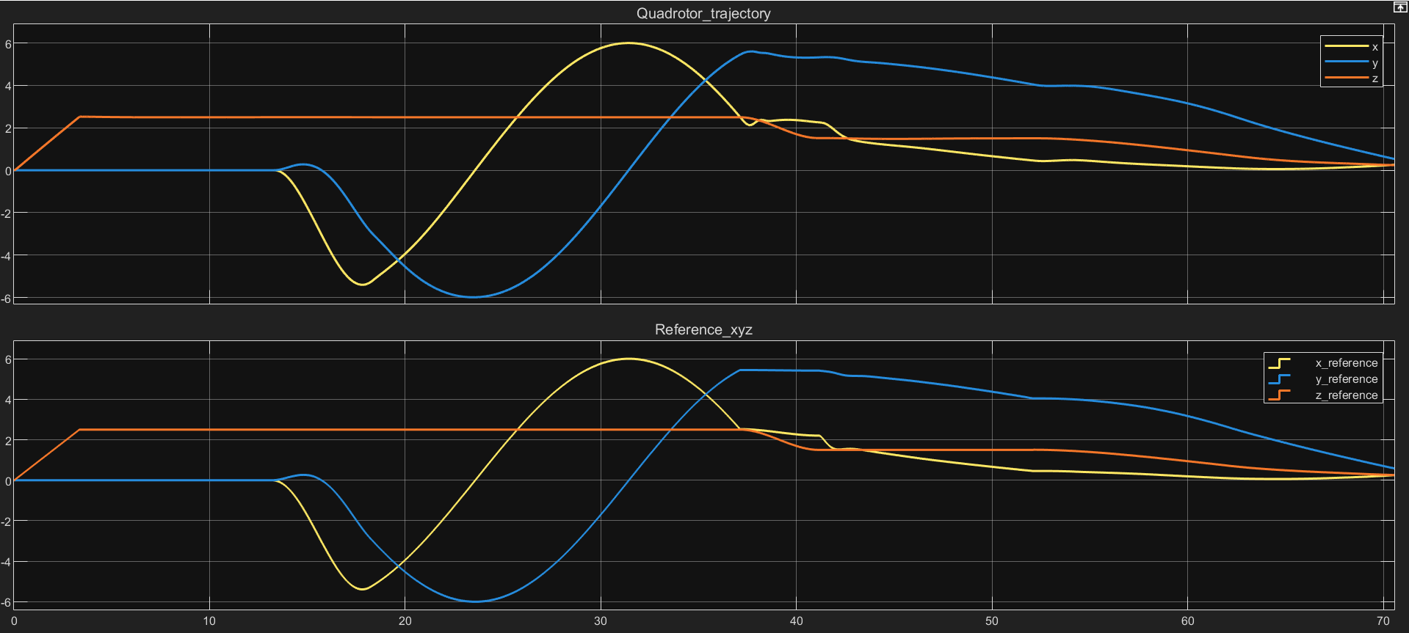
Circular Platform Trajectory: Position tracking
Takeoff
Hovering
Search
Tracking
Landing
The performance doesn’t degrade with respect to the linear case
Notes:
Now we are considering the circular trajectory case. As we can see the hovering time is extended and that’s because no platform has been detected => we also enter the search state.

Slide 20
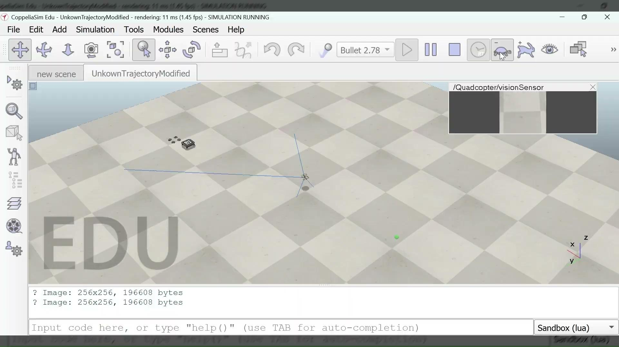
Circular Platform Trajectory: Video

Slide 21
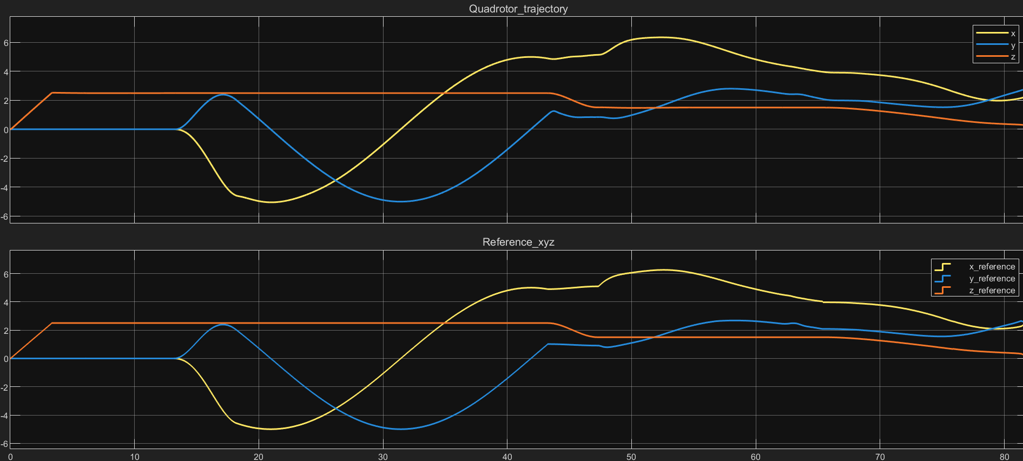
Figure-8 Platform Trajectory: Position tracking
No performance degradation

Slide 22
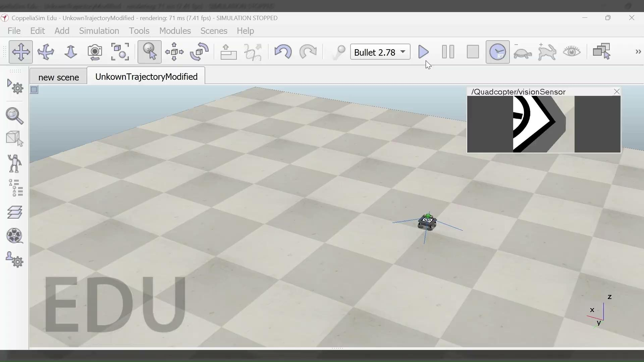
Figure-8 Trajectory: Video

Slide 23
Discussion (Implementation vs Reference)
PID vs Non-linear feedback
Our two-level cascaded PID architecture is simpler than Falanga et al.’s nonlinear feedback approach. This trade-off is acceptable for the tested regime (hover-to-landing) but limits scalability to aggressive maneuvers.
By disabling Kalman updates at large attitudes, we accept prediction-only during aggressive maneuvers. This is conservative but prevents noise injection when camera geometry is poor.
Novel:
Attitude gating

Slide 24
Discussion (Future work)
Ground truth pose from CoppeliaSim (odometry required in real applications. Camera sensor is perfect (unrealistic)
Sim-to-Real gap
Control
Constant-Velocity assumption
Euler Angle Singularities
Inverse dynamics based controller instead of PID
We worked with constant platform velocity.
Control uses Euler angles which have singularities. This is not robust to aggressive maneuvers

Slide 25
Conclusions
Our work has addressed implementing a simulation version of the reference work of Falanga et al. , achieving satisfying performance and completing the task of autonomous landing on a mobile platform obtaining comparable results without the aid of over-engineered methods.
Future work would be to extend this foundation to real hardware testing and to address cited limitations, in order to enhance robustness and allow more aggressive maneuvers

Slide 26
Thank you for the attention!

